Slide 1
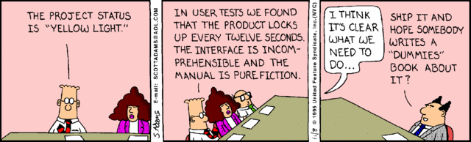
Quality Assurance (QA)
Phil Pfeiffer
Fall, 2014

Slide 2
What is Being Assured?
1st order: Product quality
  Improving what the enterprise is producing
  Focus of other courses
    Requirements quality: CSCI 5200 (SSE)
    Design quality: CSCI 5230 (soft. design)
    Implementation quality: CSCI 5220 (V & V)
  Largely outside scope of this class
2nd order: Process quality
  Assessing how the enterprise is producing it
  Focus of this lecture

Slide 3
Why Process Quality?
Hypothesis: process quality determines
  product quality
  product cost
  project success
Evidence
  deleterious effect of bad decisions on production
  success of industrial engineering in manufacturing
    Taylor's time studies on stoking furnaces
    Deming's work with Japanese auto industry
  belief that methods should apply to knowledge work

Slide 4
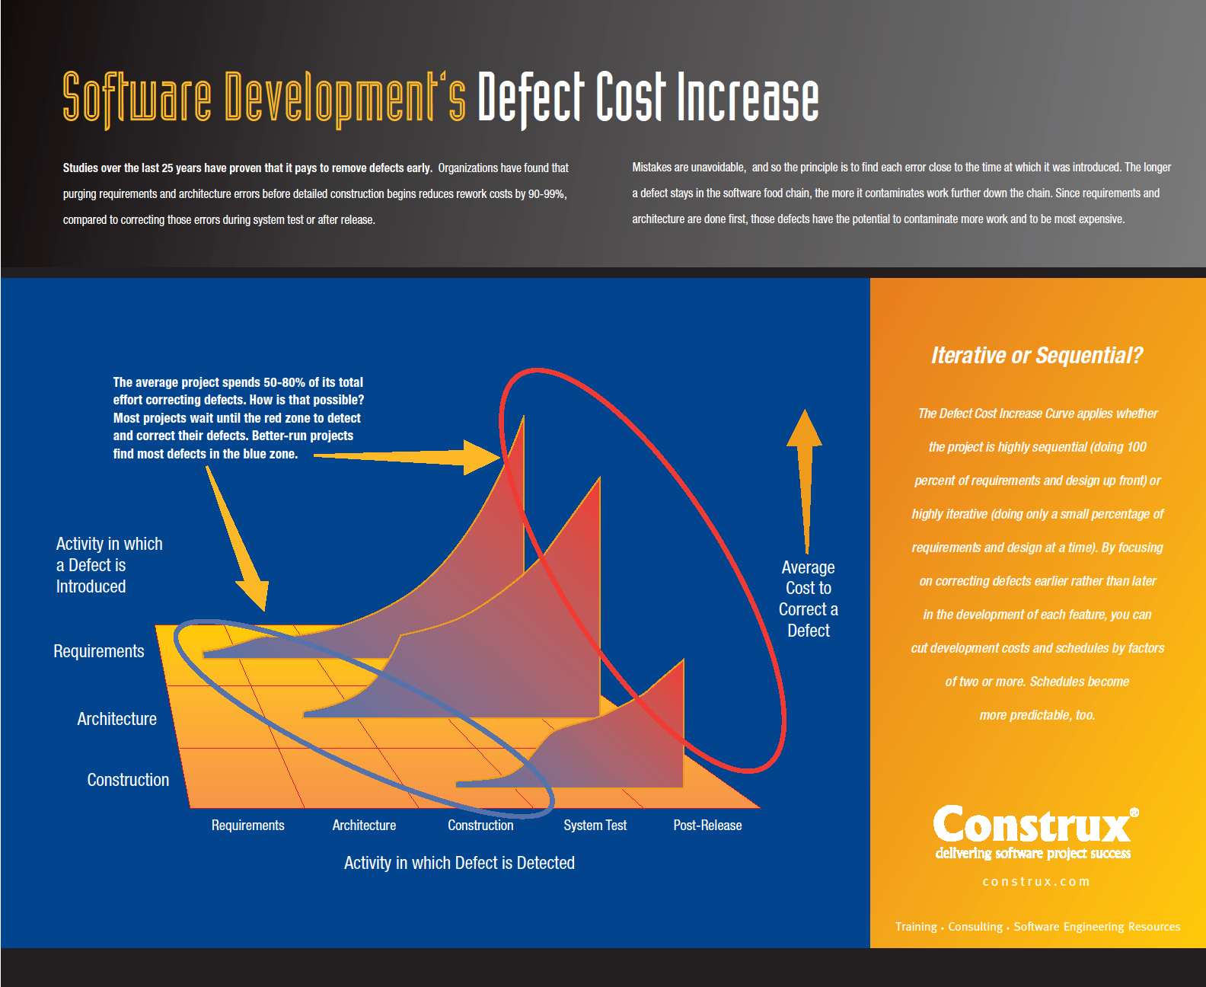
http://www.construx.com/File.ashx?cid=1459
Consequences of not "getting it right"

Slide 5
Deming and Process Quality
Full story in Halberstam, The Reckoning
Short version
  Deming, an American industrial engineer,
  tried to sell Detroit on producing better quality autos during post-WW-II manufacturing boom
  Detroit ignored Deming
  A Japanese professor who'd heard of Deming
  invited him to speak to leading executives at Nissan
  Nissan executives tried Deming's ideas
  to save face with professor
  Ideas more than doubled quality of motors in 6 mos.
Ideas evolved into Total Quality Management (TQM)
Award in Deming's honor established in Japan

Slide 6
TQM's 14 Precepts
Establish singular focus on stable set of goals
Embrace constant learning, change, customer-centered focus
Ensure quality using statistical means
Focus on reducing cost long-term
Search continuously to improve processes
Invest in great training
Lead in ways that make sure people can execute
Drive out fear; encourage open pursuit of improvement
Promote communication across all parties in process
Eliminate divisive slogans, exhortations, production targets
Avoid numerical quotas: they discourage productivity
Allow pride of workmanship; evaluate performance based on quality
Institute educational program, lifelong learning, team building
Get senior management to commit to quality and productivity
Evans, Process Improvement

Slide 7
Capability Maturity Model (CMM)
Formulated by Watts Humphrey, CMU
Based on statistical quality control (TQM), theories of Philip Crosby
Key ideas:
  Software development needs fixing
  To fix the process, transform it into a self-governing process that uses data to drive change.
  An important first step in addressing software problems is to treat the entire software task as a process that can be controlled, measured, and improved.
  -- Humphrey, Managing the Software Process
  When you can measure what you are speaking about, and express it in numbers, you know something about it, but when you cannot measure it … your knowledge is of a meager and unsatisfactory kind.
  -- Lord Kelvin (quoted by Humphrey)

Slide 8
The Model
Claim: process quality can be gauged using five level framework:
▪ Initial - organization operates without formal processes
▪ Repeatable - organization operates with a stable set of process, but has not formally defined them
▪ Defined - organization has formally defined its processes,
and uses qualitative measures to assess their operation
▪ Managed - organization has formally defined processes, and uses quantitative measures to assess their operation
▪ Optimizing - organization uses automatically generated feedback to improve its processes
Humphrey, Managing the Software Process

Slide 9
Humphrey: Justification (1989)
To date, I have observed only a few software teams at level 4 or 5, and no complete organizations.
People could reasonably argue that this limited anecdotal evidence is hardly proof of the benefits of these process levels. They would of course be right.
On the other hand, this framework has essentially fueled four centuries of scientific and engineering development.
These concepts have been proven in physics, engineering, and maufacturing, and I have yet to see evidence that they won't work for software as well.
While I cannot expect all readers to blindly share this conviction, I do assert that there is little alternative.
Humphrey, Managing the Software Process

Slide 10
Why the CMM Matters
Became a dominant model for measuring process quality in 1980's and 1990's, thanks to DoD standardization on CMM
  Required level 2 status for contracting
Some other U.S. gov't agencies followed suit

Slide 11
Some Later Data on CMM
Galin and Avrahami, in 2006 study, found ROIs from 110% - 770% in published studies of 1-level climbs
in maturity level
While authors note that self-censorship would preclude publication of failures, authors believe that dataset size
(> 400 projects, 19 sources) attests to study's validity
Study fails to compare CMM to other strategies for process improvement
Galin and Avrahami, Are CMM Program Investments Beneficial? Analyzing Past Studies, November/December 2006IEEE SOFTWARE,
http://faculty.mercer.edu/burtner_j/documents/GalinIEEECMMstudies.pdf

Slide 12
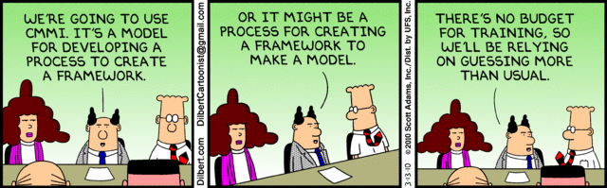
CMM-I
Extension of CMM to 34 aspects of organizational processes (as of August 2014)
Includes models for Agreement Management, Acquisition Requirements Development, Acquisition Technical Management, Acquisition Validation, Acquisition Verification, Capacity and Availability Management, Causal Analysis & Resolution, Configuration Management, Decision Analysis & Resolution, Incident Resolution and Prevention, Integrated Project Management, Measurement & Analysis, Organizational Process Definition, Organizational Process Focus, Organizational Performance Management, Organizational Process Performance, Organizational Training, Project Monitoring and Control, Product Integration, Project Planning, Process and Product Quality Assurance, Quantitative Project Management, Requirements Development, Requirements Management, Risk Management, Service Continuity, Service Delivery, Service System Development, Service System Transition, Strategic Service Management, Supplier Agreement Management, Technical Solution, Validation, and Verification
No longer mandated by U.S. government for contracting
For much, much more, see http://www.cmmifaq.info/

Slide 13
Other Models: ISO 9000 Series
General quality standard - applies to more than software
Universality of ISO makes it important
  Some entities require it for entering into contracts
Stresses eight key principles:
  Focus On The Customer
  Provide Quality Leadership
  Get Involvement of People
  Maintain A Process Approach
  Use the System Approach To Management
  Practice Continuous Improvement (CI)
  Base Decisions on Facts
  Maintain Mutually Beneficial Supplier Relationships
Documentation-heavy
  You must document how you operate your business.
  You must create documentation to comply with the standard
  You must maintain records to allow auditing to the ISO standard.
Cf.http://www.iso9000resources.com/ba/principals-iso-9001.cfm; http://www.strategosinc.com/iso_9000.htm

Slide 14
Other Models: Six Sigma
Stresses elimination of variation (i.e., defects)
in production processes
DMAIC + statistical process control
  Define ways to satisfy VOC (voice of customer)
    Yields Critical to Quality requirements
  Measure variation in performance w.r.t. CTQ's
  Analyze opportunities for eliminating variation
  Improve performance - e.g., through experimentation
  Control performance
Also uses a bag of other concepts, including fail-safe-ing processes ("po-ka yo-ke")

Slide 15
Other Models: Lean
Stresses elimination of waste in production processes
5 "S" principles
  Sort priorities
  Straighten (i.e., minimize effort within) processes
  Shine - keep parts of process clean, in working order
  Standardize - maintain principles in any design change
  Sustain - commit to ongoing application
Different approaches used to implement principles

Slide 16
Contrarian View: Importance of Chaos
Inherent lack of stable requirements for information systems implies chaos is inescapable in systems development.
[I]n thirty-five years of software building and consulting, I've never seen anything approaching zero defects in requirements work.
-- Weinberg
One aspect of instability: uncertain nature of quality
Gerald Weinberg, Software Quality Management: Volume 1 Systems Thinking

Slide 17
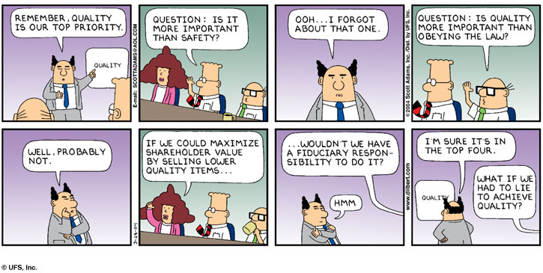
So, What is Quality?

Slide 18
So, What is Quality?
Zero defects?
▪ To users whose work was disturbed by those defects
▪ To managers who are criticized for those defects
Lots of features?
▪ To users whose work can be aided by them--if they know them
▪ To marketers who believe features sell products
Elegant coding?
▪ To developers who value opinions of peers
▪ To CS professors who appreciate elegance
High performance?
▪ To users with compute-intensive workloads
▪ To salespeople who use performance to drive sales
Low development cost?
▪ To customers who wish to buy thousands of copies of software
▪ To project managers on tight budgets
Rapid development?
▪ To users whose work is waiting on the software
▪ To marketers who wish to be first to market
User friendliness?
▪ To users who spend eight hours per day using software
▪ To users who can't remember UIs from one day to another
Gerald Weinberg, Software Quality Management: Volume 1 Systems Thinking

Slide 19

Weinberg on Quality
Quality is value to some person(s)
  What will people pay or do
  to have requirements met?
More quality for one person may be less quality for another
Whose opinion of quality is to count when making decisions?
  Decisions about quality are always political, emotional
  Decisions, moreover, are often hidden even from conscious minds of those making them
Gerald Weinberg,
Software Quality Management: Volume 1 Systems Thinking

Slide 20
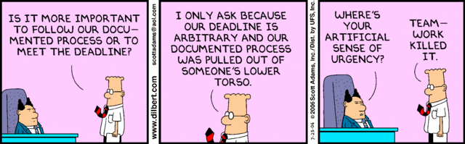

Slide 21
Contrarian View: Inevitability of Chaos
Excessive order is self-defeating in chaotic environments
  Misses opportunities for innovation (Bach, Gabriel)
  Prioritizes processes over people, the entities who identify opportunities for innovation (Bach)
  Overlooks success of products that aren't perfect, companies with less than stable processes (Bach, Gabriel, Weinberg)
  [Patterns of operation] are not more or less mature, they are just
  more or less fitting. Of course, some people have an emotional
  need for perfection, and they will impose this emotional need on
  everything they do. Their comparisons have nothing to do with the
  organization's problems, but with their own.
  The quest for unjustified perfection is not mature, but infantile.
Richard Gabriel, Lisp: Good News, Bad News, How to Win Big
Gerald Weinberg, Software Quality Management: Volume 1 Systems Thinking
James Bach, Process Evolution in a Mad World

Slide 22
Bach's View of Process Management
Use personal initiative to promote change
Focus on real risk
Work in harmony with your team
Design processes that tolerate being ignored and executed somewhat incorrectly
Experiment with ideas for processes
Introduce new processes as extensions to existing processes
Start small, score quickly
Use mentoring to teach processes, not manuals
Evaluate process effectiveness frequently
Formalize processes only as required
James Bach, Process Evolution in a Mad World

Slide 23
Checklists in Process Assurance
Gawande on checklists
  essential for controlling complex processes
  modern professions dominated by complex processes
Bad checklists - impractical
  vague and imprecise.
  too long, hard to use
  made at desks with no awareness of situations where used
  treat users as stupid; try to spell out every single step
Good checklists - above all, practical
  precise; efficient; to the point
  easy to use even in most difficult situations.
  provide reminders of only the most critical and important steps – the ones that even the highly skilled professionals could miss.
How does the PMBOK rate as a checklist?
Dan Boorman, Boeing - cited in Berkun, Scott, "Book review: The checklist manifesto",
http://www.scottberkun.com/blog/2010/book-review-the-checklist-manifesto/

